Slide 1
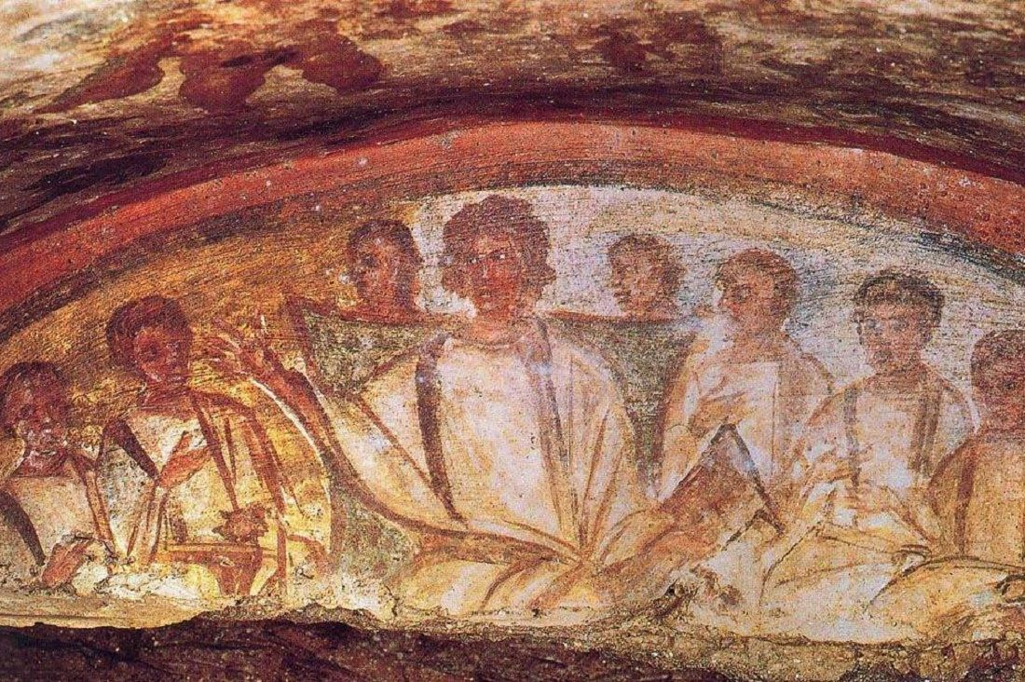
Christianity (III)

Slide 2
Development of Bible, concluded
summary
further steps
the argument
Nag Hammadi & Second-Century Christianity
discovery
contents
the Christian myth in the second century

Slide 3
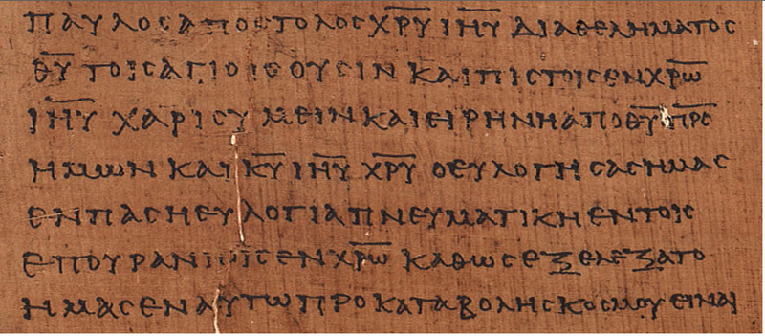
Review

Slide 4
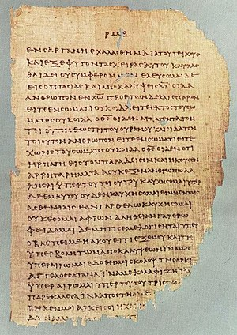
Development of the Christian Bible: Summary
Composite: 27 Greek books added to Hebrew Bible
Normally is a translation (into English, Latin, and many other languages)
Hand-written manuscripts, with considerable disagreement
Canonization

Slide 5
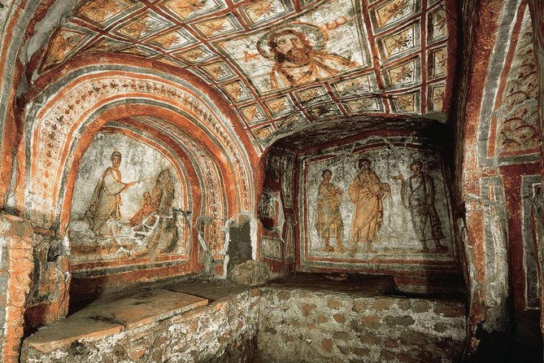
Further Steps Back
Composition
Copying
Circulation
Imitation
Sub-collections
Use & Interpretation

Slide 6
The whole process
composition → copies → circulation → imitation → collection → canonization → manuscript transmission → critical editions of the “original” text → translation → use → interpretation

Slide 7
The argument?
the Bible isn’t just “there”
it is a product of human labor, of effort
not by any one human being, or any small group of human beings
created over a period of about 2000 years, with the tremendous input from many people
the Bible is a work of collective and on-going intellectual activity
that labor continues today

Slide 8
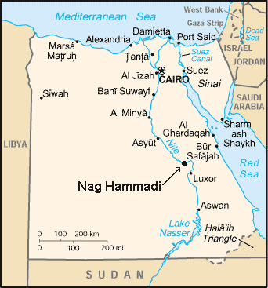
Nag Hammadi, 1945

Slide 9
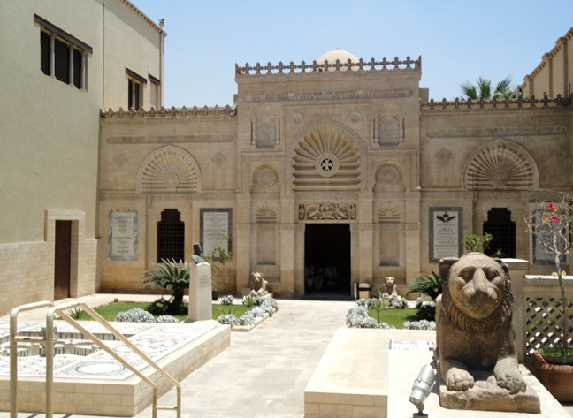
Coptic Museum, Cairo (Egypt)

Slide 10
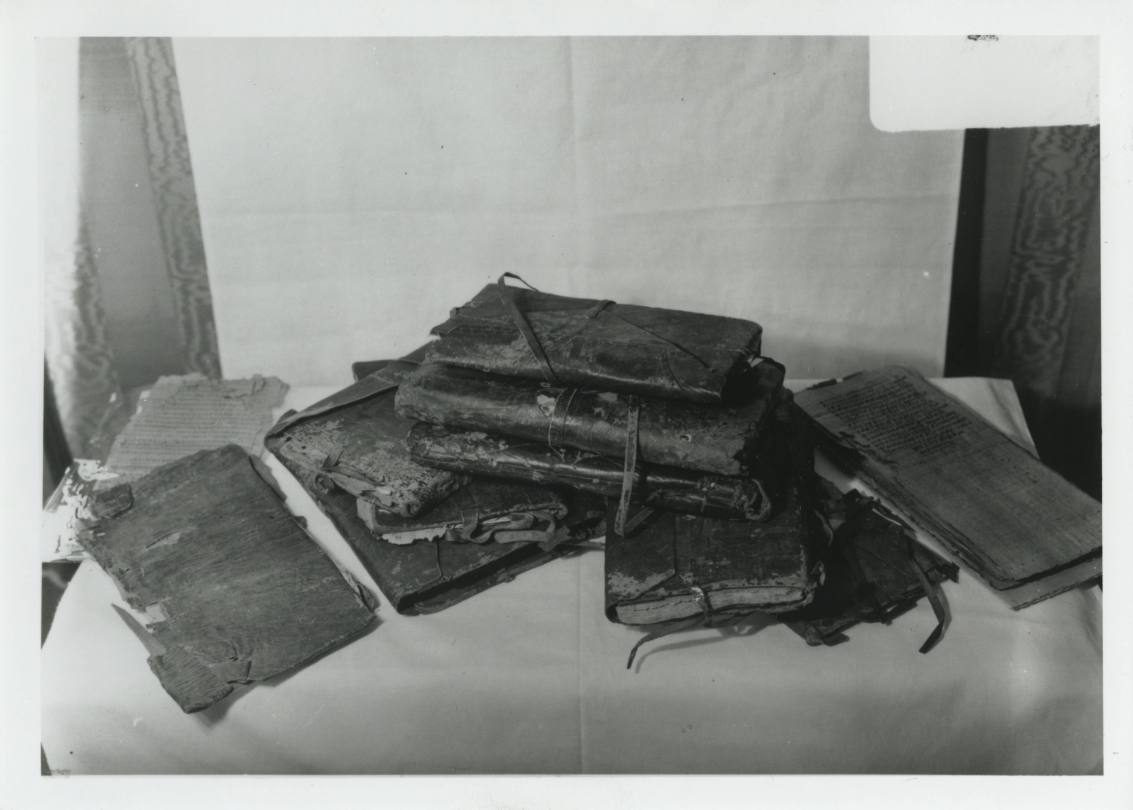
The Nag Hammadi Books

Slide 11
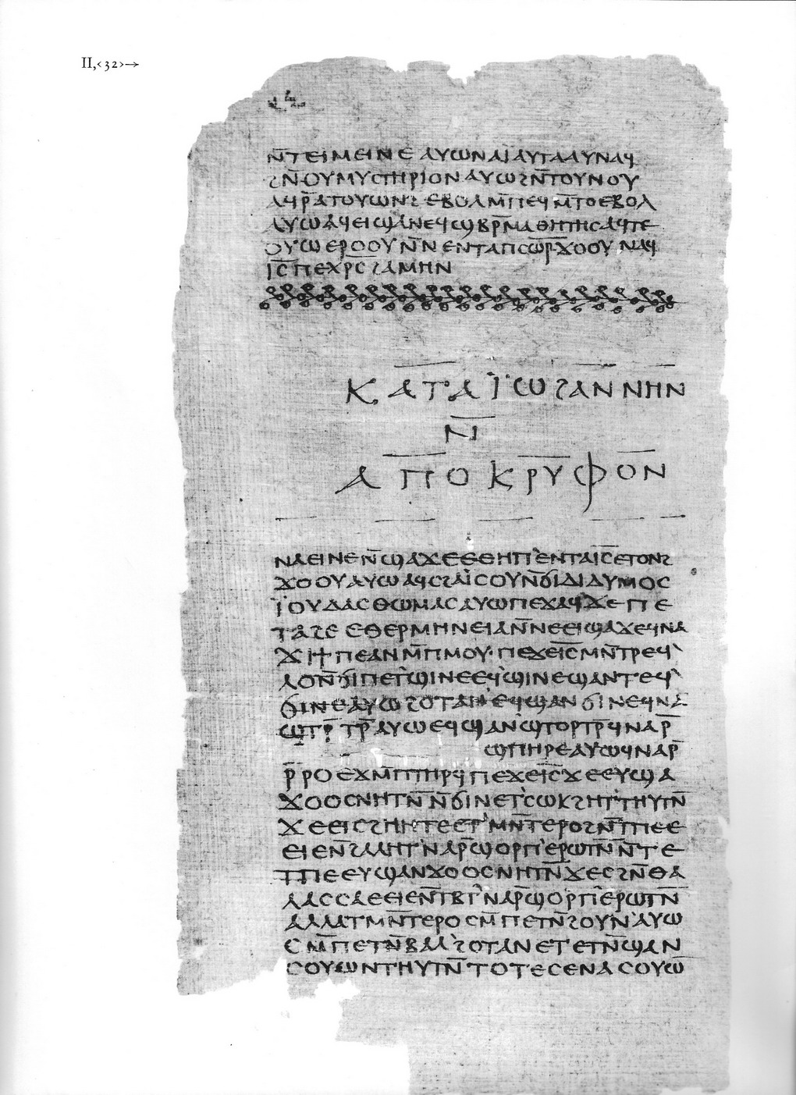
Coptic
Originally composed in Greek
Anthologies
Books date to 350 CE
Originally composed around 120-320 or so, many in the second century
“Gnosticism”

Slide 12
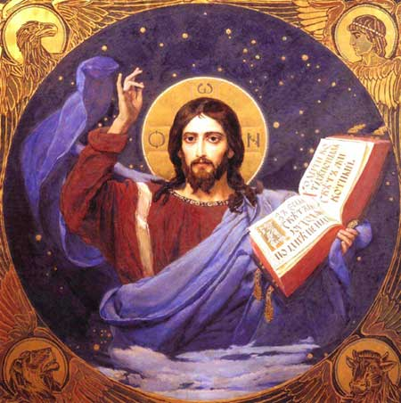
Contents
The Secret Book of James
On the Origin of the World
The Dialogue of the Savior
The Apocalypse of Paul
The Apocalypse of Peter
Second Treatise of the Great Seth

Slide 13
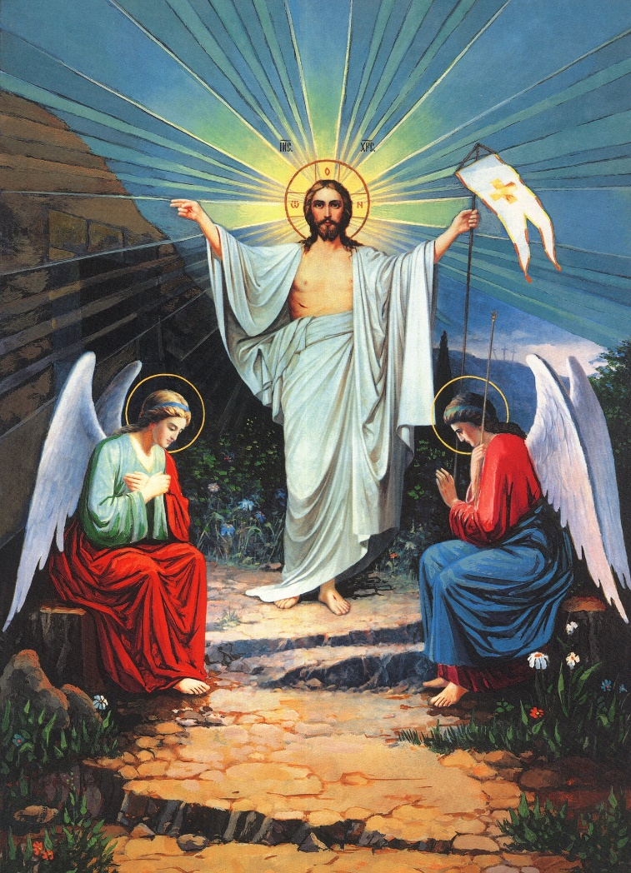
The Christian Myth & Nag Hammadi
The current version of the Christian myth (more or less): original sin brought death to the human race, but God, the creator of the universe, made a new covenant with people to the effect that faith in Jesus, God’s unique son, who had come to earth in human form, died, and been raised from the dead, would lead to forgiveness of sins and hence eternal life.

Slide 14
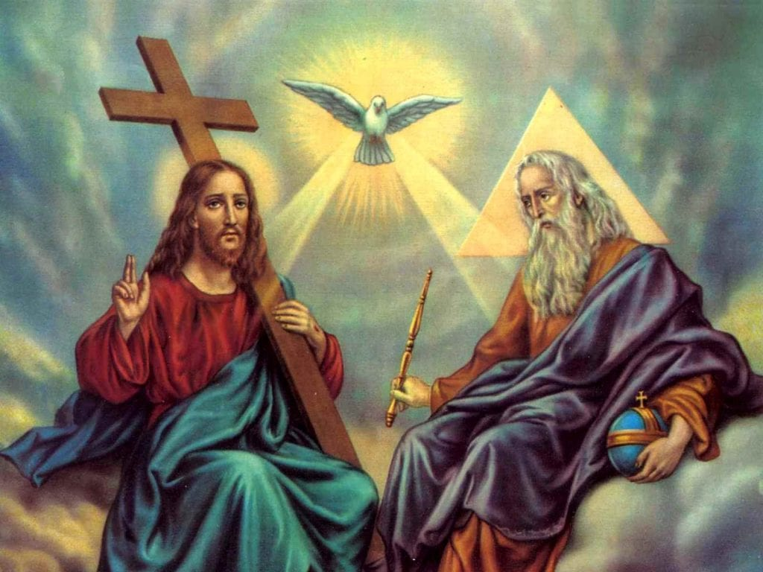
The Trinity
One God
Three persons
Father
Son
Holy Spirit
God has “internal structure”

Slide 15
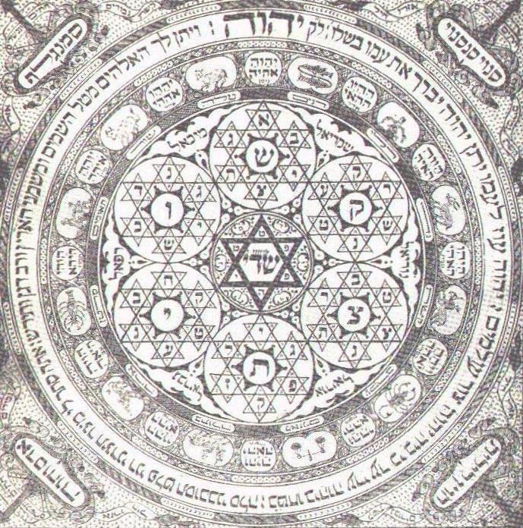
Nag Hammadi “Gnostic” ideas: emanation
God thinking
Produces thoughts called Aeons
Aeons, in pairs, produce new Aeons
Complex “internal structure” of God → more than 3 entities

Slide 16
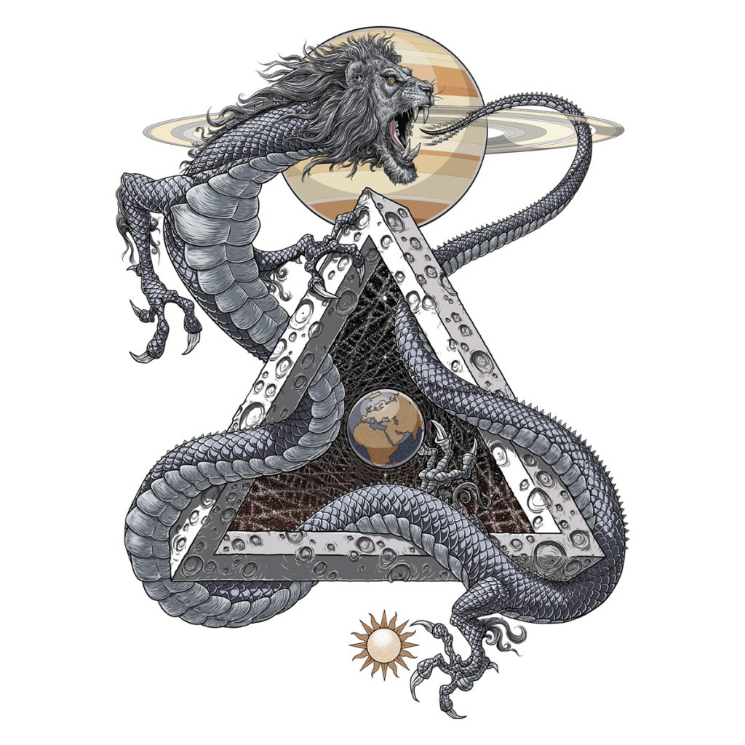
The fall of Sophia
Sophia = Wisdom
Creation without partner
Projects her power into something
It’s monstrous
Yaldabaoth
The Demiurge

Slide 17
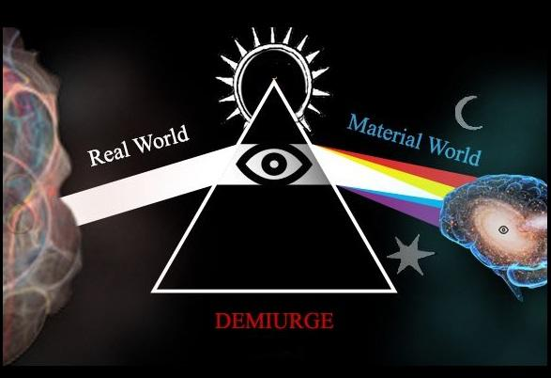
The cosmos
Cosmos created by Yaldabaoth/demiurge
Archons
God of the Bible

Slide 18
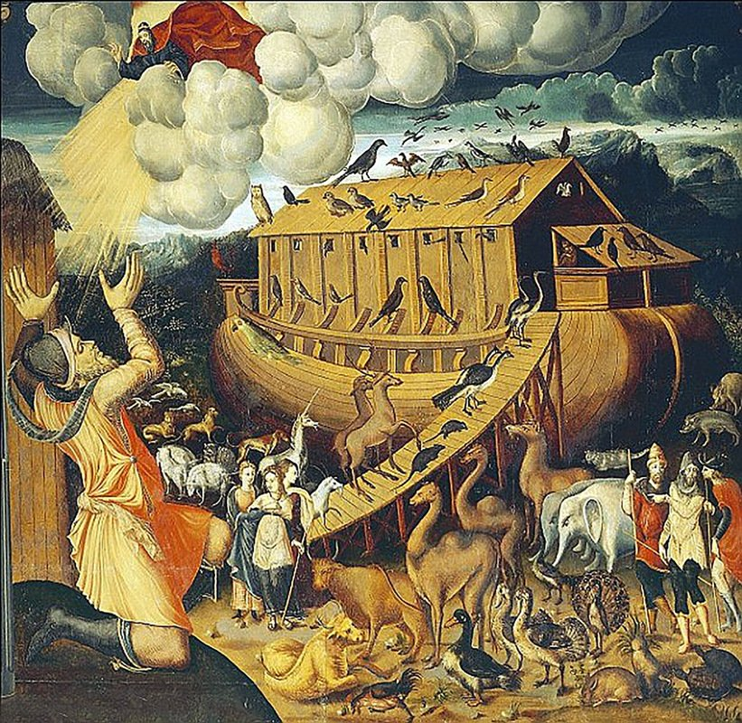
The god of the Bible & his misdeeds
Eden
Flood
Fire and brimstone
Jealousy and anger

Slide 19
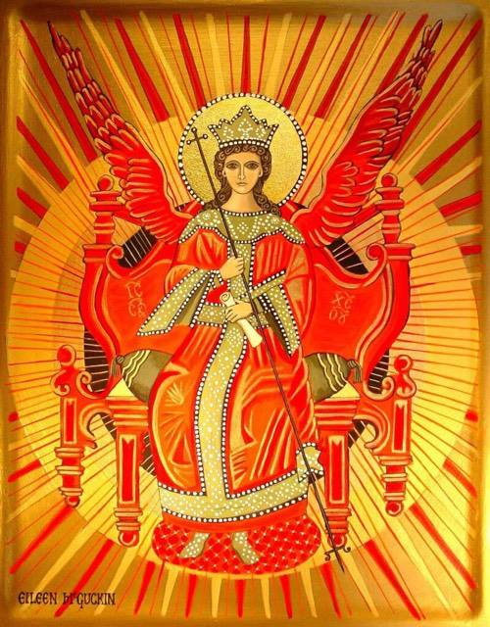
Salvation
Defect of Sophia
Blew power into Yaldabaoth
He blew power into humans
That power seeks to return to its heavenly home
Jesus as revealer
Double-salvation

Slide 20

Motivations for this myth
why is the world bad? where does suffering, death, and bad emotions like anger come from?
if the world is bad, how could it have been created by a good god?
why does the god described in the Jewish Bible seem to do bad things?
how does Jesus with his teachings of love and grace relate to the angry god of the Jewish Bible?
if Jesus was a teacher or revealer, what was he revealing and where did he get it from?

Slide 21
Short answer options
What are the two main practices in contemporary Judaism? Say two things about each. Answer in complete sentences.
Why did anti-Judaism transform into anti-Semitism? Explain the differences between anti-Judaism and anti-Semitism.
Before the adoption of the printing press in Europe, how were copies of the New Testament (and the rest of the Bible, for that matter) transmitted? What was the result of this kind of transmission?

